Slide 1

Introduction to Probabilistic Machine Learning
Ralf Herbrich
Graphical Models: Inference

Slide 2
Overview
Factor Graphs
The Sum-Product Algorithm
Practical Considerations in Message Passing
Approximate Message Passing

Slide 3
Overview
Factor Graphs
The Sum-Product Algorithm
Practical Considerations in Message Passing
Approximate Message Passing

Slide 4



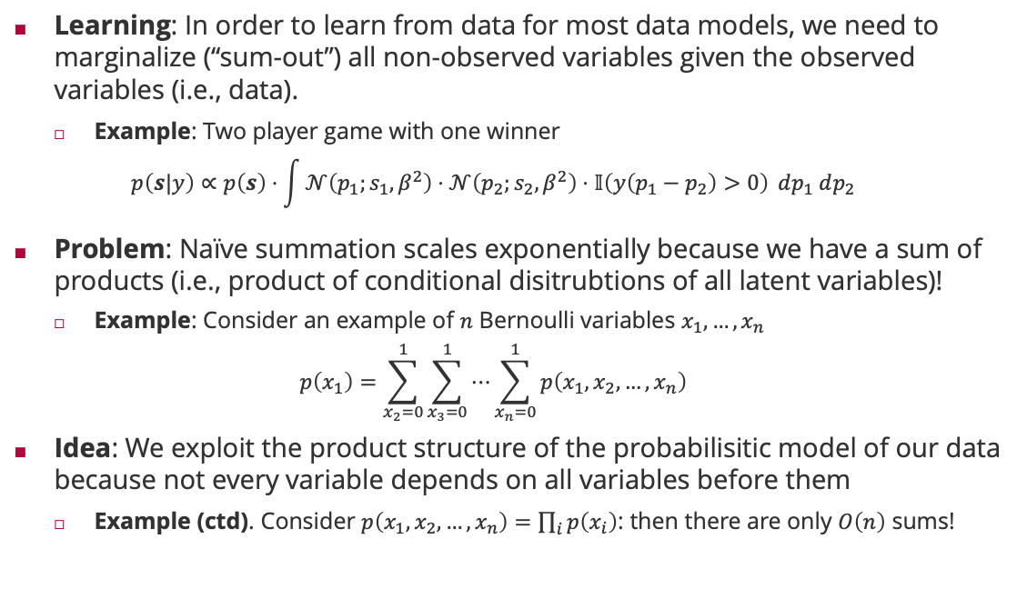



Inference in Probabilistic Models
Learning: In order to learn from data for most data models, we need to marginalize (“sum-out”) all non-observed variables given the observed variables (i.e., data).
Example: Two player game with one winner
$$p\left(s|y\right)∝p\left(s\right)⋅\int{𝒩\left(p_{1};s_{1},β^{2}\right)⋅𝒩\left(p_{2};s_{2},β^{2}\right)⋅𝕀\left(y\left(p_{1}−p_{2}\right)>0\right)} dp_{1} dp_{2}$$
Problem: Naïve summation scales exponentially because we have a sum of products (i.e., product of conditional disitrubtions of all latent variables)!
Example: Consider an example of $n$ Bernoulli variables $x_{1},…,x_{n}$
$$p\left(x_{1}\right)=\sum_{x_{2}=0}^{1}{\sum_{x_{3}=0}^{1}{⋯\sum_{x_{n}=0}^{1}{p\left(x_{1},x_{2},…,x_{n}\right)}}}$$
Idea: We exploit the product structure of the probabilisitic model of our data because not every variable depends on all variables before them
Example (ctd). Consider $p\left(x_{1},x_{2},…,x_{n}\right)=\prod_{i}{p\left(x_{i}\right)}$: then there are only $O\left(n\right)$ sums!
$$s_{1}$$
$$s_{2}$$
$$p_{1}$$
$$p_{2}$$
$$y$$
$2^{n−1}$ summations

Slide 5





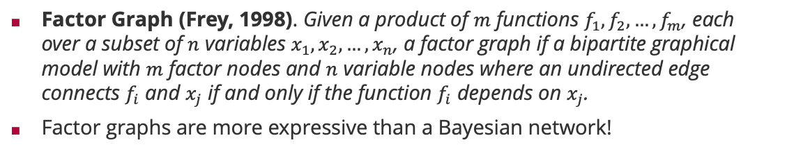








Factor Graphs
Factor Graph (Frey, 1998). Given a product of $m$ functions $f_{1},f_{2},…,f_{m}$, each over a subset of $n$ variables $x_{1},x_{2},…,x_{n}$, a factor graph if a bipartite graphical model with $m$ factor nodes and $n$ variable nodes where an undirected edge connects $f_{i}$ and $x_{j}$ if and only if the function $f_{i}$ depends on $x_{j}$.
Factor graphs are more expressive than a Bayesian network!
Brendan Frey (1968 – )
Bayesian network
Corresponding factor graph
Factor graph with more structure
$$x_{1}$$
$$x_{2}$$
$$x_{1}$$
$$x_{2}$$
$$x_{1}$$
$$x_{2}$$
$$x_{3}$$
$$x_{3}$$
$$x_{3}$$
$$p\left(x_{1},x_{2},x_{3}\right)=p\left(x_{1}\right)⋅p\left(x_{2}\right)⋅p\left(x_{3}|x_{1},x_{2}\right)$$
$$p\left(x_{1},x_{2},x_{3}\right)=f_{1}\left(x_{1}\right)⋅f_{2}\left(x_{2}\right)⋅f_{3}\left(x_{3},x_{1},x_{2}\right)$$
$$p\left(x_{1},x_{2},x_{3}\right)=f_{1}\left(x_{1}\right)⋅f_{2}\left(x_{2}\right)⋅f_{3}\left(x_{1},x_{3}\right)⋅f_{4}\left(x_{2},x_{3}\right)$$
Structure in $p\left(x_{3}|x_{1},x_{2}\right)$

Slide 6
Overview
Factor Graphs
The Sum-Product Algorithm
Practical Considerations in Message Passing
Approximate Message Passing

Slide 7





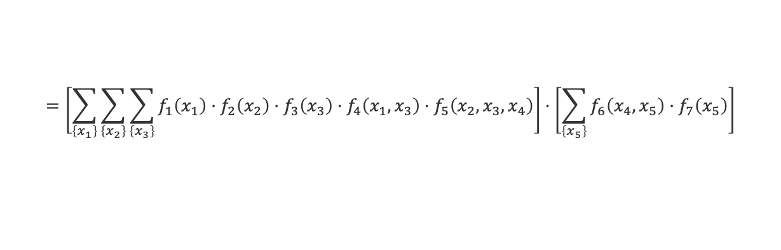



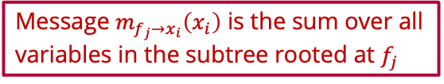









Sum-Product Algorithm: Marginals
$$f_{3}$$
$$f_{1}$$
$$f_{4}$$
$$x_{3}$$
$$x_{1}$$
$$f_{5}$$
$$f_{6}$$
$$f_{7}$$
$$x_{4}$$
$$x_{5}$$
$$f_{2}$$
$$m_{f_{5}→x_{4}}\left(x_{4}\right)$$
$$m_{f_{6}→x_{4}}\left(x_{4}\right)$$
$$x_{2}$$
Message $m_{f_{j}→x_{i}}\left(x_{i}\right)$ is the sum over all variables in the subtree rooted at $f_{j}$
$$p\left(x_{4}\right)=\sum_{\left\{x_{1}\right\}}{\sum_{\left\{x_{2}\right\}}{\sum_{\left\{x_{3}\right\}}{\sum_{\left\{x_{5}\right\}}{f_{1}\left(x_{1}\right)⋅f_{2}\left(x_{2}\right)⋅f_{3}\left(x_{2}\right)⋅f_{4}\left(x_{1},x_{3}\right)⋅f_{5}\left(x_{2},x_{3},x_{4}\right)⋅f_{6}\left(x_{4},x_{5}\right)⋅f_{7}\left(x_{5}\right)}}}}$$
$$=\left[\sum_{\left\{x_{1}\right\}}{\sum_{\left\{x_{2}\right\}}{\sum_{\left\{x_{3}\right\}}{f_{1}\left(x_{1}\right)⋅f_{2}\left(x_{2}\right)⋅f_{3}\left(x_{3}\right)⋅f_{4}\left(x_{1},x_{3}\right)⋅f_{5}\left(x_{2},x_{3},x_{4}\right)}}}\right]⋅\left[\sum_{\left\{x_{5}\right\}}{f_{6}\left(x_{4},x_{5}\right)⋅f_{7}\left(x_{5}\right)}\right]$$
$$m_{f_{5}→x_{4}}\left(x_{4}\right)$$
$$m_{f_{6}→x_{4}}\left(x_{4}\right)$$
Marginals are the product of all incoming messages from neighbouring factors!

Slide 8

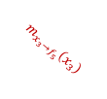
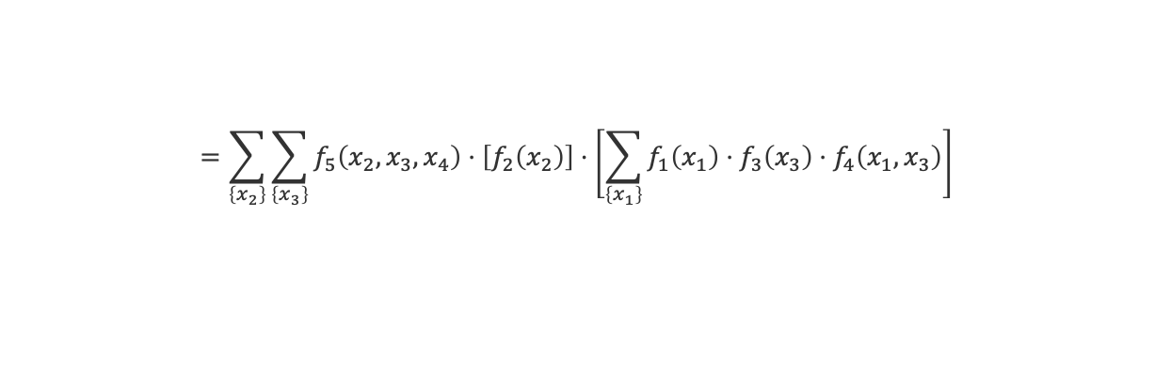

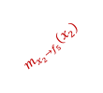





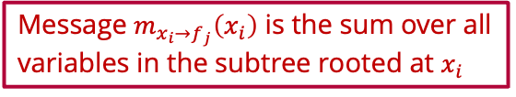
Sum-Product Algorithm: Message from Factor to Variable
$$f_{3}$$
$$f_{1}$$
$$f_{4}$$
$$x_{3}$$
$$m_{x_{3}→f_{5}}\left(x_{3}\right)$$
$$x_{1}$$
$$f_{5}$$
$$f_{6}$$
$$f_{7}$$
$$x_{4}$$
$$x_{5}$$
$$f_{2}$$
$$m_{f_{5}→x_{4}}\left(x_{4}\right)$$
$$m_{f_{6}→x_{4}}\left(x_{4}\right)$$
$$x_{2}$$
$$m_{x_{2}→f_{5}}\left(x_{2}\right)$$
Message $m_{x_{i}→f_{j}}\left(x_{i}\right)$ is the sum over all variables in the subtree rooted at $x_{i}$
$$m_{f_{5}→x_{4}}\left(x_{4}\right)=\sum_{\left\{x_{1}\right\}}{\sum_{\left\{x_{2}\right\}}{\sum_{\left\{x_{3}\right\}}{f_{1}\left(x_{1}\right)⋅f_{2}\left(x_{2}\right)⋅f_{3}\left(x_{3}\right)⋅f_{4}\left(x_{1},x_{3}\right)⋅f_{5}\left(x_{2},x_{3},x_{4}\right)}}}$$
$$=\sum_{\left\{x_{2}\right\}}{\sum_{\left\{x_{3}\right\}}{f_{5}\left(x_{2},x_{3},x_{4}\right)⋅\left[f_{2}\left(x_{2}\right)\right]⋅\left[\sum_{\left\{x_{1}\right\}}{f_{1}\left(x_{1}\right)⋅f_{3}\left(x_{3}\right)⋅f_{4}\left(x_{1},x_{3}\right)}\right]}}$$
$$m_{x_{2}→f_{5}}\left(x_{2}\right)$$
$$m_{x_{3}→f_{5}}\left(x_{3}\right)$$
Messages from a factor to a variable sum out all neighboring variables weighted by their incoming message

Slide 9




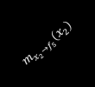






Sum-Product Algorithm: Message from Variable to Factor
$$f_{3}$$
$$m_{f_{3}→x_{3}}\left(x_{3}\right)$$
$$f_{1}$$
$$f_{4}$$
$$x_{3}$$
$$m_{x_{3}→f_{5}}\left(x_{3}\right)$$
$$x_{1}$$
$$f_{5}$$
$$f_{6}$$
$$f_{7}$$
$$m_{f_{4}→x_{3}}\left(x_{3}\right)$$
$$x_{4}$$
$$x_{5}$$
$$f_{2}$$
$$m_{f_{5}→x_{4}}\left(x_{4}\right)$$
$$m_{f_{6}→x_{4}}\left(x_{4}\right)$$
$$x_{2}$$
$$m_{x_{2}→f_{5}}\left(x_{2}\right)$$
$$m_{x_{3}→f_{5}}\left(x_{3}\right)=\sum_{\left\{x_{1}\right\}}{f_{1}\left(x_{1}\right)⋅f_{3}\left(x_{3}\right)⋅f_{4}\left(x_{1},x_{3}\right)}$$
$$=\left[f_{3}\left(x_{3}\right)\right]⋅\left[\sum_{\left\{x_{1}\right\}}{f_{1}\left(x_{1}\right)⋅f_{4}\left(x_{1},x_{3}\right)}\right]$$
$$m_{f_{3}→x_{3}}\left(x_{3}\right)$$
$$m_{f_{4}→x_{3}}\left(x_{3}\right)$$
Messages from a variable to a factor multiply incoming message from neighboring factors

Slide 10

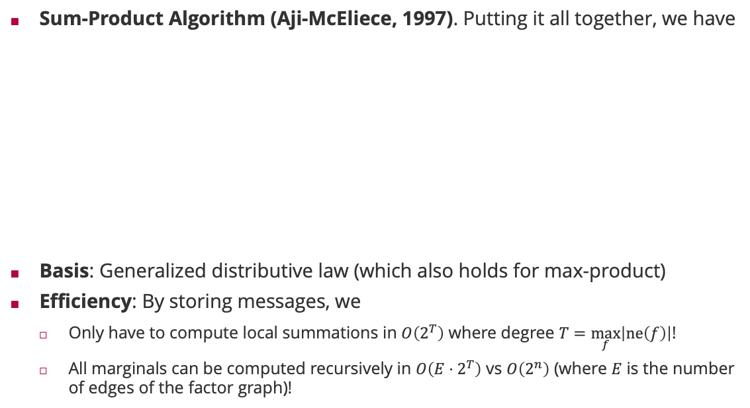
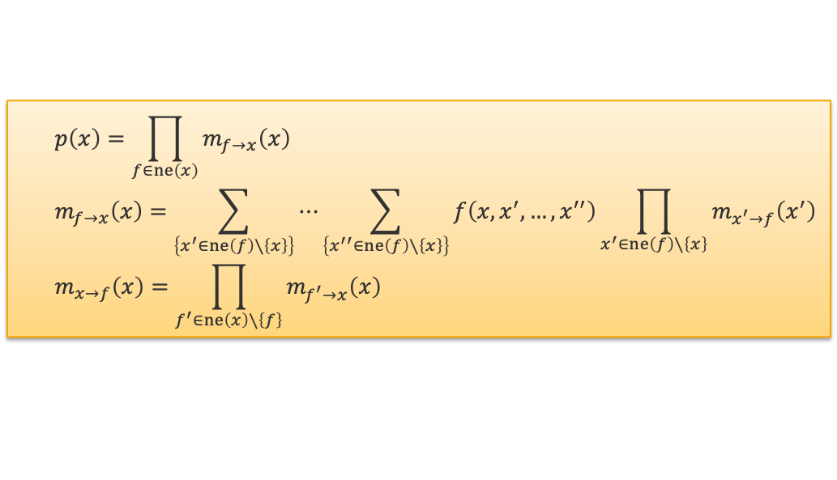
Sum-Product Algorithm
Sum-Product Algorithm (Aji-McEliece, 1997). Putting it all together, we have
Basis: Generalized distributive law (which also holds for max-product)
Efficiency: By storing messages, we
Only have to compute local summations in $O\left(2^{T}\right)$ where degree $T=\max_{f}\left|ne\left(f\right)\right|$!
All marginals can be computed recursively in $O\left(E⋅2^{T}\right)$ vs $O\left(2^{n}\right)$ (where $E$ is the number of edges of the factor graph)!
$$p\left(x\right)=\prod_{f∈ne\left(x\right)}{m_{f→x}\left(x\right)}$$
$$m_{f→x}\left(x\right)=\sum_{\left\{x^{′}∈ne\left(f\right)∖\left\{x\right\}\right\}}{⋯\sum_{\left\{x^{′′}∈ne\left(f\right)∖\left\{x\right\}\right\}}{f\left(x,x^{′},…,x^{′′}\right)\prod_{x^{′}∈ne\left(f\right)∖\left\{x\right\}}{m_{x^{′}→f}\left(x^{′}\right)}}}$$
$$m_{x→f}\left(x\right)=\prod_{f^{′}∈ne\left(x\right)∖\left\{f\right\}}{m_{f^{′}→x}\left(x\right)}$$
Robert McEliece (1942 – 2019)

Slide 11
Overview
Factor Graphs
The Sum-Product Algorithm
Practical Considerations in Message Passing
Approximate Message Passing

Slide 12

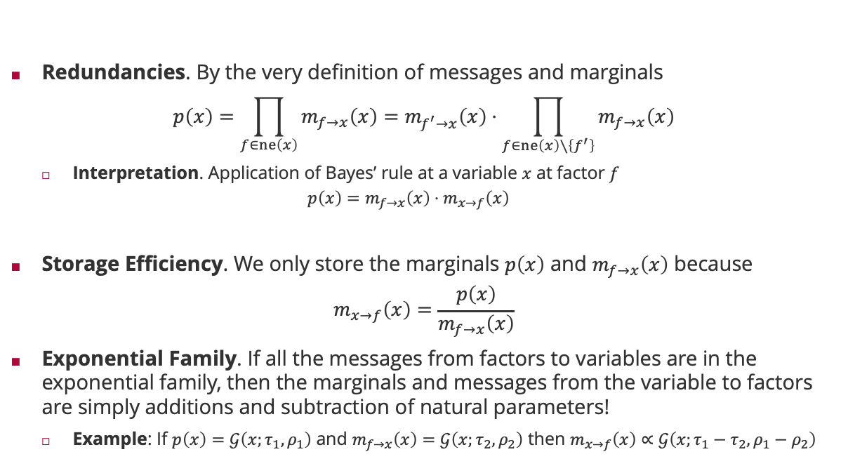

Even more efficiency
Redundancies. By the very definition of messages and marginals
$$p\left(x\right)=\prod_{f∈ne\left(x\right)}{m_{f→x}\left(x\right)}=m_{f^{′}→x}\left(x\right)⋅\prod_{f∈ne\left(x\right)∖\left\{f^{′}\right\}}{m_{f→x}\left(x\right)}$$
Interpretation. Application of Bayes’ rule at a variable $x$ at factor $f$
$$p\left(x\right)=m_{f→x}\left(x\right)⋅m_{x→f}\left(x\right)$$
Storage Efficiency. We only store the marginals $p\left(x\right)$ and $m_{f→x}\left(x\right)$ because
$$m_{x→f}\left(x\right)=\frac{p\left(x\right)}{m_{f→x}\left(x\right)}$$
Exponential Family. If all the messages from factors to variables are in the exponential family, then the marginals and messages from the variable to factors are simply additions and subtraction of natural parameters!
Example: If $p\left(x\right)=𝒢\left(x;τ_{1},ρ_{1}\right)$ and $m_{f→x}\left(x\right)=𝒢\left(x;τ_{2},ρ_{2}\right)$ then $m_{x→f}\left(x\right)∝𝒢\left(x;τ_{1}−τ_{2},ρ_{1}−ρ_{2}\right)$
$$m_{x→f^{′}}\left(x\right)$$
posterior
Likelihood $×$ normalization
prior

Slide 13
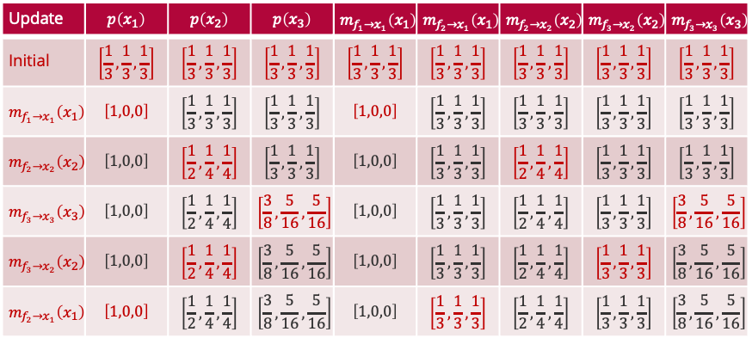
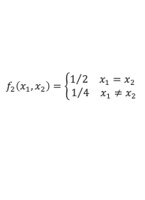

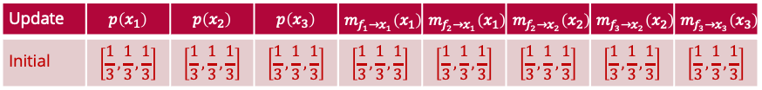
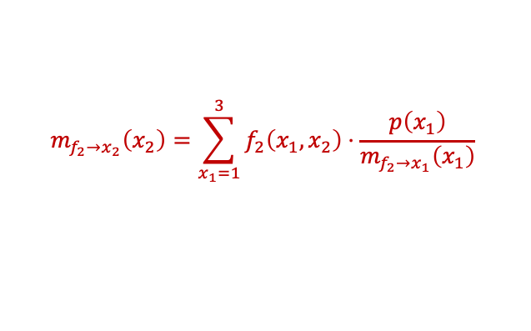
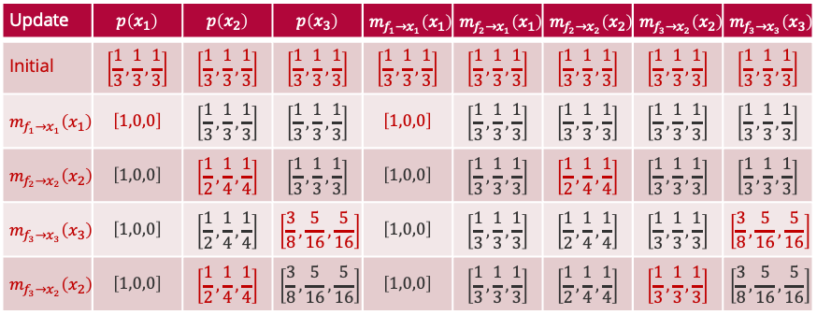


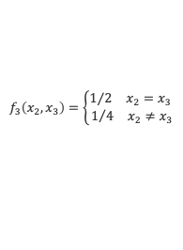

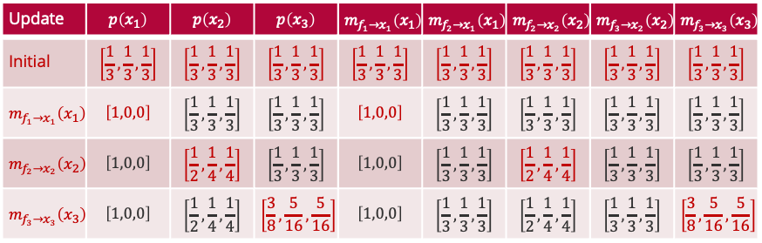

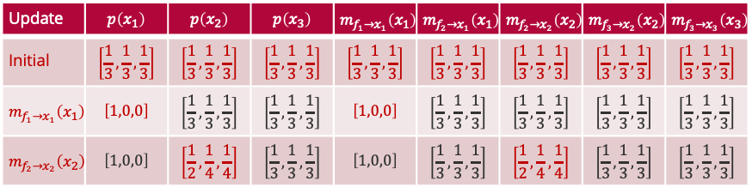



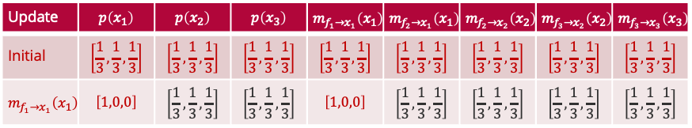
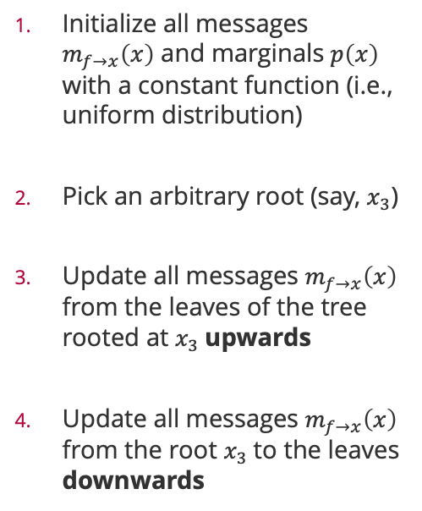


A Practical Implementation
Initialize all messages $m_{f→x}\left(x\right)$ and marginals $p\left(x\right)$ with a constant function (i.e., uniform distribution)
Pick an arbitrary root (say, $x_{3}$)
Update all messages $m_{f→x}\left(x\right)$ from the leaves of the tree rooted at $x_{3}$upwards
Update all messages $m_{f→x}\left(x\right)$ from the root $x_{3}$to the leaves downwards
$$f_{1}\left(x_{1}\right)=𝕀\left(x=1\right)$$
$$f_{2}\left(x_{1},x_{2}\right)=\left\{\begin{aligned}1/2 x_{1}=x_{2} \\ 1/4 x_{1}≠x_{2}\end{aligned}\right.$$
$$f_{3}\left(x_{2},x_{3}\right)=\left\{\begin{aligned}1/2 x_{2}=x_{3} \\ 1/4 x_{2}≠x_{3}\end{aligned}\right.$$
$$x_{1}$$
$$x_{2}$$
$$x_{3}$$
$$m_{f_{1}→x_{1}}\left(x_{1}\right)$$
$$m_{f_{2}→x_{1}}\left(x_{1}\right)$$
$$m_{f_{2}→x_{2}}\left(x_{2}\right)$$
$$m_{f_{3}→x_{2}}\left(x_{2}\right)$$
$$m_{f_{3}→x_{3}}\left(x_{3}\right)$$
Update | $$p\left(x_{1}\right)$$ | $$p\left(x_{2}\right)$$ | $$p\left(x_{3}\right)$$ | $$m_{f_{1}→x_{1}}\left(x_{1}\right)$$ | $$m_{f_{2}→x_{1}}\left(x_{1}\right)$$ | $$m_{f_{2}→x_{2}}\left(x_{2}\right)$$ | $$m_{f_{3}→x_{2}}\left(x_{2}\right)$$ | $$m_{f_{3}→x_{3}}\left(x_{3}\right)$$
Initial | $$\left[\frac{1}{3},\frac{1}{3},\frac{1}{3}\right]$$ | $$\left[\frac{1}{3},\frac{1}{3},\frac{1}{3}\right]$$ | $$\left[\frac{1}{3},\frac{1}{3},\frac{1}{3}\right]$$ | $$\left[\frac{1}{3},\frac{1}{3},\frac{1}{3}\right]$$ | $$\left[\frac{1}{3},\frac{1}{3},\frac{1}{3}\right]$$ | $$\left[\frac{1}{3},\frac{1}{3},\frac{1}{3}\right]$$ | $$\left[\frac{1}{3},\frac{1}{3},\frac{1}{3}\right]$$ | $$\left[\frac{1}{3},\frac{1}{3},\frac{1}{3}\right]$$
Update | $$p\left(x_{1}\right)$$ | $$p\left(x_{2}\right)$$ | $$p\left(x_{3}\right)$$ | $$m_{f_{1}→x_{1}}\left(x_{1}\right)$$ | $$m_{f_{2}→x_{1}}\left(x_{1}\right)$$ | $$m_{f_{2}→x_{2}}\left(x_{2}\right)$$ | $$m_{f_{3}→x_{2}}\left(x_{2}\right)$$ | $$m_{f_{3}→x_{3}}\left(x_{3}\right)$$
Initial | $$\left[\frac{1}{3},\frac{1}{3},\frac{1}{3}\right]$$ | $$\left[\frac{1}{3},\frac{1}{3},\frac{1}{3}\right]$$ | $$\left[\frac{1}{3},\frac{1}{3},\frac{1}{3}\right]$$ | $$\left[\frac{1}{3},\frac{1}{3},\frac{1}{3}\right]$$ | $$\left[\frac{1}{3},\frac{1}{3},\frac{1}{3}\right]$$ | $$\left[\frac{1}{3},\frac{1}{3},\frac{1}{3}\right]$$ | $$\left[\frac{1}{3},\frac{1}{3},\frac{1}{3}\right]$$ | $$\left[\frac{1}{3},\frac{1}{3},\frac{1}{3}\right]$$
$$m_{f_{1}→x_{1}}\left(x_{1}\right)$$ | $$\left[1,0,0\right]$$ | $$\left[\frac{1}{3},\frac{1}{3},\frac{1}{3}\right]$$ | $$\left[\frac{1}{3},\frac{1}{3},\frac{1}{3}\right]$$ | $$\left[1,0,0\right]$$ | $$\left[\frac{1}{3},\frac{1}{3},\frac{1}{3}\right]$$ | $$\left[\frac{1}{3},\frac{1}{3},\frac{1}{3}\right]$$ | $$\left[\frac{1}{3},\frac{1}{3},\frac{1}{3}\right]$$ | $$\left[\frac{1}{3},\frac{1}{3},\frac{1}{3}\right]$$
Update | $$p\left(x_{1}\right)$$ | $$p\left(x_{2}\right)$$ | $$p\left(x_{3}\right)$$ | $$m_{f_{1}→x_{1}}\left(x_{1}\right)$$ | $$m_{f_{2}→x_{1}}\left(x_{1}\right)$$ | $$m_{f_{2}→x_{2}}\left(x_{2}\right)$$ | $$m_{f_{3}→x_{2}}\left(x_{2}\right)$$ | $$m_{f_{3}→x_{3}}\left(x_{3}\right)$$
Initial | $$\left[\frac{1}{3},\frac{1}{3},\frac{1}{3}\right]$$ | $$\left[\frac{1}{3},\frac{1}{3},\frac{1}{3}\right]$$ | $$\left[\frac{1}{3},\frac{1}{3},\frac{1}{3}\right]$$ | $$\left[\frac{1}{3},\frac{1}{3},\frac{1}{3}\right]$$ | $$\left[\frac{1}{3},\frac{1}{3},\frac{1}{3}\right]$$ | $$\left[\frac{1}{3},\frac{1}{3},\frac{1}{3}\right]$$ | $$\left[\frac{1}{3},\frac{1}{3},\frac{1}{3}\right]$$ | $$\left[\frac{1}{3},\frac{1}{3},\frac{1}{3}\right]$$
$$m_{f_{1}→x_{1}}\left(x_{1}\right)$$ | $$\left[1,0,0\right]$$ | $$\left[\frac{1}{3},\frac{1}{3},\frac{1}{3}\right]$$ | $$\left[\frac{1}{3},\frac{1}{3},\frac{1}{3}\right]$$ | $$\left[1,0,0\right]$$ | $$\left[\frac{1}{3},\frac{1}{3},\frac{1}{3}\right]$$ | $$\left[\frac{1}{3},\frac{1}{3},\frac{1}{3}\right]$$ | $$\left[\frac{1}{3},\frac{1}{3},\frac{1}{3}\right]$$ | $$\left[\frac{1}{3},\frac{1}{3},\frac{1}{3}\right]$$
$$m_{f_{2}→x_{2}}\left(x_{2}\right)$$ | $$\left[1,0,0\right]$$ | $$\left[\frac{1}{2},\frac{1}{4},\frac{1}{4}\right]$$ | $$\left[\frac{1}{3},\frac{1}{3},\frac{1}{3}\right]$$ | $$\left[1,0,0\right]$$ | $$\left[\frac{1}{3},\frac{1}{3},\frac{1}{3}\right]$$ | $$\left[\frac{1}{2},\frac{1}{4},\frac{1}{4}\right]$$ | $$\left[\frac{1}{3},\frac{1}{3},\frac{1}{3}\right]$$ | $$\left[\frac{1}{3},\frac{1}{3},\frac{1}{3}\right]$$
Update | $$p\left(x_{1}\right)$$ | $$p\left(x_{2}\right)$$ | $$p\left(x_{3}\right)$$ | $$m_{f_{1}→x_{1}}\left(x_{1}\right)$$ | $$m_{f_{2}→x_{1}}\left(x_{1}\right)$$ | $$m_{f_{2}→x_{2}}\left(x_{2}\right)$$ | $$m_{f_{3}→x_{2}}\left(x_{2}\right)$$ | $$m_{f_{3}→x_{3}}\left(x_{3}\right)$$
Initial | $$\left[\frac{1}{3},\frac{1}{3},\frac{1}{3}\right]$$ | $$\left[\frac{1}{3},\frac{1}{3},\frac{1}{3}\right]$$ | $$\left[\frac{1}{3},\frac{1}{3},\frac{1}{3}\right]$$ | $$\left[\frac{1}{3},\frac{1}{3},\frac{1}{3}\right]$$ | $$\left[\frac{1}{3},\frac{1}{3},\frac{1}{3}\right]$$ | $$\left[\frac{1}{3},\frac{1}{3},\frac{1}{3}\right]$$ | $$\left[\frac{1}{3},\frac{1}{3},\frac{1}{3}\right]$$ | $$\left[\frac{1}{3},\frac{1}{3},\frac{1}{3}\right]$$
$$m_{f_{1}→x_{1}}\left(x_{1}\right)$$ | $$\left[1,0,0\right]$$ | $$\left[\frac{1}{3},\frac{1}{3},\frac{1}{3}\right]$$ | $$\left[\frac{1}{3},\frac{1}{3},\frac{1}{3}\right]$$ | $$\left[1,0,0\right]$$ | $$\left[\frac{1}{3},\frac{1}{3},\frac{1}{3}\right]$$ | $$\left[\frac{1}{3},\frac{1}{3},\frac{1}{3}\right]$$ | $$\left[\frac{1}{3},\frac{1}{3},\frac{1}{3}\right]$$ | $$\left[\frac{1}{3},\frac{1}{3},\frac{1}{3}\right]$$
$$m_{f_{2}→x_{2}}\left(x_{2}\right)$$ | $$\left[1,0,0\right]$$ | $$\left[\frac{1}{2},\frac{1}{4},\frac{1}{4}\right]$$ | $$\left[\frac{1}{3},\frac{1}{3},\frac{1}{3}\right]$$ | $$\left[1,0,0\right]$$ | $$\left[\frac{1}{3},\frac{1}{3},\frac{1}{3}\right]$$ | $$\left[\frac{1}{2},\frac{1}{4},\frac{1}{4}\right]$$ | $$\left[\frac{1}{3},\frac{1}{3},\frac{1}{3}\right]$$ | $$\left[\frac{1}{3},\frac{1}{3},\frac{1}{3}\right]$$
$$m_{f_{3}→x_{3}}\left(x_{3}\right)$$ | $$\left[1,0,0\right]$$ | $$\left[\frac{1}{2},\frac{1}{4},\frac{1}{4}\right]$$ | $$\left[\frac{3}{8},\frac{5}{16},\frac{5}{16}\right]$$ | $$\left[1,0,0\right]$$ | $$\left[\frac{1}{3},\frac{1}{3},\frac{1}{3}\right]$$ | $$\left[\frac{1}{2},\frac{1}{4},\frac{1}{4}\right]$$ | $$\left[\frac{1}{3},\frac{1}{3},\frac{1}{3}\right]$$ | $$\left[\frac{3}{8},\frac{5}{16},\frac{5}{16}\right]$$
Update | $$p\left(x_{1}\right)$$ | $$p\left(x_{2}\right)$$ | $$p\left(x_{3}\right)$$ | $$m_{f_{1}→x_{1}}\left(x_{1}\right)$$ | $$m_{f_{2}→x_{1}}\left(x_{1}\right)$$ | $$m_{f_{2}→x_{2}}\left(x_{2}\right)$$ | $$m_{f_{3}→x_{2}}\left(x_{2}\right)$$ | $$m_{f_{3}→x_{3}}\left(x_{3}\right)$$
Initial | $$\left[\frac{1}{3},\frac{1}{3},\frac{1}{3}\right]$$ | $$\left[\frac{1}{3},\frac{1}{3},\frac{1}{3}\right]$$ | $$\left[\frac{1}{3},\frac{1}{3},\frac{1}{3}\right]$$ | $$\left[\frac{1}{3},\frac{1}{3},\frac{1}{3}\right]$$ | $$\left[\frac{1}{3},\frac{1}{3},\frac{1}{3}\right]$$ | $$\left[\frac{1}{3},\frac{1}{3},\frac{1}{3}\right]$$ | $$\left[\frac{1}{3},\frac{1}{3},\frac{1}{3}\right]$$ | $$\left[\frac{1}{3},\frac{1}{3},\frac{1}{3}\right]$$
$$m_{f_{1}→x_{1}}\left(x_{1}\right)$$ | $$\left[1,0,0\right]$$ | $$\left[\frac{1}{3},\frac{1}{3},\frac{1}{3}\right]$$ | $$\left[\frac{1}{3},\frac{1}{3},\frac{1}{3}\right]$$ | $$\left[1,0,0\right]$$ | $$\left[\frac{1}{3},\frac{1}{3},\frac{1}{3}\right]$$ | $$\left[\frac{1}{3},\frac{1}{3},\frac{1}{3}\right]$$ | $$\left[\frac{1}{3},\frac{1}{3},\frac{1}{3}\right]$$ | $$\left[\frac{1}{3},\frac{1}{3},\frac{1}{3}\right]$$
$$m_{f_{2}→x_{2}}\left(x_{2}\right)$$ | $$\left[1,0,0\right]$$ | $$\left[\frac{1}{2},\frac{1}{4},\frac{1}{4}\right]$$ | $$\left[\frac{1}{3},\frac{1}{3},\frac{1}{3}\right]$$ | $$\left[1,0,0\right]$$ | $$\left[\frac{1}{3},\frac{1}{3},\frac{1}{3}\right]$$ | $$\left[\frac{1}{2},\frac{1}{4},\frac{1}{4}\right]$$ | $$\left[\frac{1}{3},\frac{1}{3},\frac{1}{3}\right]$$ | $$\left[\frac{1}{3},\frac{1}{3},\frac{1}{3}\right]$$
$$m_{f_{3}→x_{3}}\left(x_{3}\right)$$ | $$\left[1,0,0\right]$$ | $$\left[\frac{1}{2},\frac{1}{4},\frac{1}{4}\right]$$ | $$\left[\frac{3}{8},\frac{5}{16},\frac{5}{16}\right]$$ | $$\left[1,0,0\right]$$ | $$\left[\frac{1}{3},\frac{1}{3},\frac{1}{3}\right]$$ | $$\left[\frac{1}{2},\frac{1}{4},\frac{1}{4}\right]$$ | $$\left[\frac{1}{3},\frac{1}{3},\frac{1}{3}\right]$$ | $$\left[\frac{3}{8},\frac{5}{16},\frac{5}{16}\right]$$
$$m_{f_{3}→x_{2}}\left(x_{2}\right)$$ | $$\left[1,0,0\right]$$ | $$\left[\frac{1}{2},\frac{1}{4},\frac{1}{4}\right]$$ | $$\left[\frac{3}{8},\frac{5}{16},\frac{5}{16}\right]$$ | $$\left[1,0,0\right]$$ | $$\left[\frac{1}{3},\frac{1}{3},\frac{1}{3}\right]$$ | $$\left[\frac{1}{2},\frac{1}{4},\frac{1}{4}\right]$$ | $$\left[\frac{1}{3},\frac{1}{3},\frac{1}{3}\right]$$ | $$\left[\frac{3}{8},\frac{5}{16},\frac{5}{16}\right]$$
Update | $$p\left(x_{1}\right)$$ | $$p\left(x_{2}\right)$$ | $$p\left(x_{3}\right)$$ | $$m_{f_{1}→x_{1}}\left(x_{1}\right)$$ | $$m_{f_{2}→x_{1}}\left(x_{1}\right)$$ | $$m_{f_{2}→x_{2}}\left(x_{2}\right)$$ | $$m_{f_{3}→x_{2}}\left(x_{2}\right)$$ | $$m_{f_{3}→x_{3}}\left(x_{3}\right)$$
Initial | $$\left[\frac{1}{3},\frac{1}{3},\frac{1}{3}\right]$$ | $$\left[\frac{1}{3},\frac{1}{3},\frac{1}{3}\right]$$ | $$\left[\frac{1}{3},\frac{1}{3},\frac{1}{3}\right]$$ | $$\left[\frac{1}{3},\frac{1}{3},\frac{1}{3}\right]$$ | $$\left[\frac{1}{3},\frac{1}{3},\frac{1}{3}\right]$$ | $$\left[\frac{1}{3},\frac{1}{3},\frac{1}{3}\right]$$ | $$\left[\frac{1}{3},\frac{1}{3},\frac{1}{3}\right]$$ | $$\left[\frac{1}{3},\frac{1}{3},\frac{1}{3}\right]$$
$$m_{f_{1}→x_{1}}\left(x_{1}\right)$$ | $$\left[1,0,0\right]$$ | $$\left[\frac{1}{3},\frac{1}{3},\frac{1}{3}\right]$$ | $$\left[\frac{1}{3},\frac{1}{3},\frac{1}{3}\right]$$ | $$\left[1,0,0\right]$$ | $$\left[\frac{1}{3},\frac{1}{3},\frac{1}{3}\right]$$ | $$\left[\frac{1}{3},\frac{1}{3},\frac{1}{3}\right]$$ | $$\left[\frac{1}{3},\frac{1}{3},\frac{1}{3}\right]$$ | $$\left[\frac{1}{3},\frac{1}{3},\frac{1}{3}\right]$$
$$m_{f_{2}→x_{2}}\left(x_{2}\right)$$ | $$\left[1,0,0\right]$$ | $$\left[\frac{1}{2},\frac{1}{4},\frac{1}{4}\right]$$ | $$\left[\frac{1}{3},\frac{1}{3},\frac{1}{3}\right]$$ | $$\left[1,0,0\right]$$ | $$\left[\frac{1}{3},\frac{1}{3},\frac{1}{3}\right]$$ | $$\left[\frac{1}{2},\frac{1}{4},\frac{1}{4}\right]$$ | $$\left[\frac{1}{3},\frac{1}{3},\frac{1}{3}\right]$$ | $$\left[\frac{1}{3},\frac{1}{3},\frac{1}{3}\right]$$
$$m_{f_{3}→x_{3}}\left(x_{3}\right)$$ | $$\left[1,0,0\right]$$ | $$\left[\frac{1}{2},\frac{1}{4},\frac{1}{4}\right]$$ | $$\left[\frac{3}{8},\frac{5}{16},\frac{5}{16}\right]$$ | $$\left[1,0,0\right]$$ | $$\left[\frac{1}{3},\frac{1}{3},\frac{1}{3}\right]$$ | $$\left[\frac{1}{2},\frac{1}{4},\frac{1}{4}\right]$$ | $$\left[\frac{1}{3},\frac{1}{3},\frac{1}{3}\right]$$ | $$\left[\frac{3}{8},\frac{5}{16},\frac{5}{16}\right]$$
$$m_{f_{3}→x_{2}}\left(x_{2}\right)$$ | $$\left[1,0,0\right]$$ | $$\left[\frac{1}{2},\frac{1}{4},\frac{1}{4}\right]$$ | $$\left[\frac{3}{8},\frac{5}{16},\frac{5}{16}\right]$$ | $$\left[1,0,0\right]$$ | $$\left[\frac{1}{3},\frac{1}{3},\frac{1}{3}\right]$$ | $$\left[\frac{1}{2},\frac{1}{4},\frac{1}{4}\right]$$ | $$\left[\frac{1}{3},\frac{1}{3},\frac{1}{3}\right]$$ | $$\left[\frac{3}{8},\frac{5}{16},\frac{5}{16}\right]$$
$$m_{f_{2}→x_{1}}\left(x_{1}\right)$$ | $$\left[1,0,0\right]$$ | $$\left[\frac{1}{2},\frac{1}{4},\frac{1}{4}\right]$$ | $$\left[\frac{3}{8},\frac{5}{16},\frac{5}{16}\right]$$ | $$\left[1,0,0\right]$$ | $$\left[\frac{1}{3},\frac{1}{3},\frac{1}{3}\right]$$ | $$\left[\frac{1}{2},\frac{1}{4},\frac{1}{4}\right]$$ | $$\left[\frac{1}{3},\frac{1}{3},\frac{1}{3}\right]$$ | $$\left[\frac{3}{8},\frac{5}{16},\frac{5}{16}\right]$$
$$m_{f_{2}→x_{2}}\left(x_{2}\right)=\sum_{x_{1}=1}^{3}{f_{2}\left(x_{1},x_{2}\right)⋅\frac{p\left(x_{1}\right)}{m_{f_{2}→x_{1}}\left(x_{1}\right)}}$$
$$m_{x_{1}→f_{2}}\left(x_{1}\right)$$

Slide 14
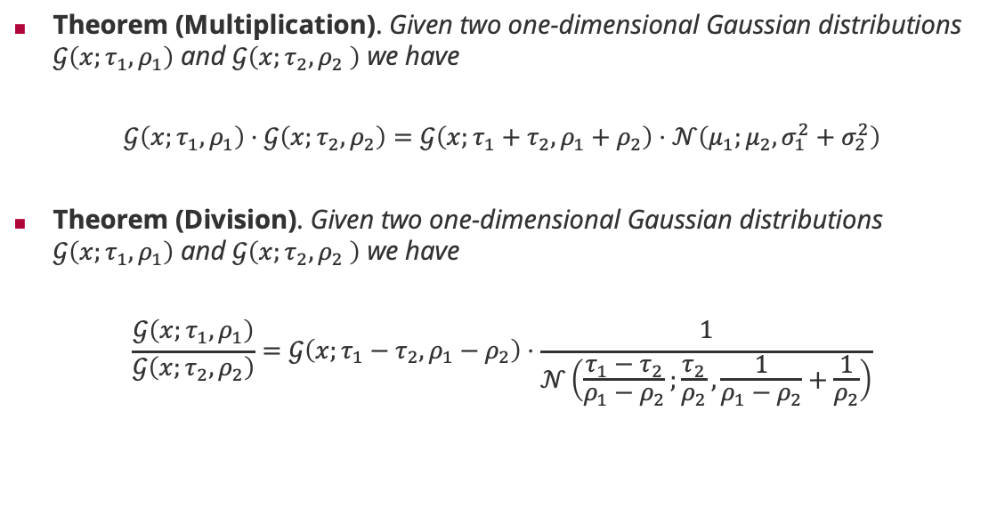
Normal Distributions and the Product Rule
Theorem (Multiplication). Given two one-dimensional Gaussian distributions $𝒢\left(x;τ_{1},ρ_{1}\right)$ and $𝒢\left(x;τ_{2},ρ_{2} \right)$ we have
$$𝒢\left(x;τ_{1},ρ_{1}\right)⋅𝒢\left(x;τ_{2},ρ_{2}\right)=𝒢\left(x;τ_{1}+τ_{2},ρ_{1}+ρ_{2}\right)⋅𝒩\left(μ_{1};μ_{2},σ_{1}^{2}+σ_{2}^{2}\right)$$
Theorem (Division). Given two one-dimensional Gaussian distributions $𝒢\left(x;τ_{1},ρ_{1}\right)$ and $𝒢\left(x;τ_{2},ρ_{2} \right)$ we have
$$\frac{𝒢\left(x;τ_{1},ρ_{1}\right)}{𝒢\left(x;τ_{2},ρ_{2}\right)}=𝒢\left(x;τ_{1}−τ_{2},ρ_{1}−ρ_{2}\right)⋅\frac{1}{𝒩\left(\frac{τ_{1}−τ_{2}}{ρ_{1}−ρ_{2}};\frac{τ_{2}}{ρ_{2}},\frac{1}{ρ_{1}−ρ_{2}}+\frac{1}{ρ_{2}}\right)}$$
Gaussian density (as normalization constant)
Additive updates!
Gaussian density (as normalization constant)
Subtractive updates!

Slide 15
Overview
Factor Graphs
The Sum-Product Algorithm
Practical Considerations in Message Passing
Approximate Message Passing

Slide 16
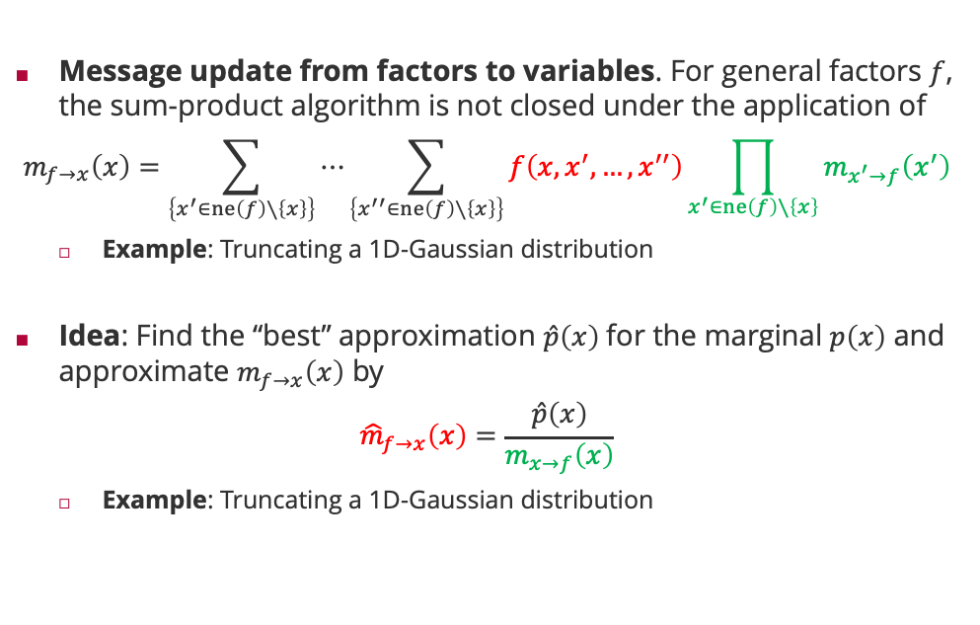
Approximate Message Passing
Message update from factors to variables. For general factors $f$, the sum-product algorithm is not closed under the application of
$$m_{f→x}\left(x\right)=\sum_{\left\{x^{′}∈ne\left(f\right)∖\left\{x\right\}\right\}}{⋯\sum_{\left\{x^{′′}∈ne\left(f\right)∖\left\{x\right\}\right\}}{f\left(x,x^{′},…,x^{′′}\right)\prod_{x^{′}∈ne\left(f\right)∖\left\{x\right\}}{m_{x^{′}→f}\left(x^{′}\right)}}}$$
Example: Truncating a 1D-Gaussian distribution
Idea: Find the “best” approximation $\hat{p}\left(x\right)$for the marginal $p\left(x\right)$ and approximate $m_{f→x}\left(x\right)$ by
$${\hat{m}}_{f→x}\left(x\right)=\frac{\hat{p}\left(x\right)}{m_{x→f}\left(x\right)}$$
Example: Truncating a 1D-Gaussian distribution

Slide 17

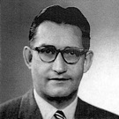
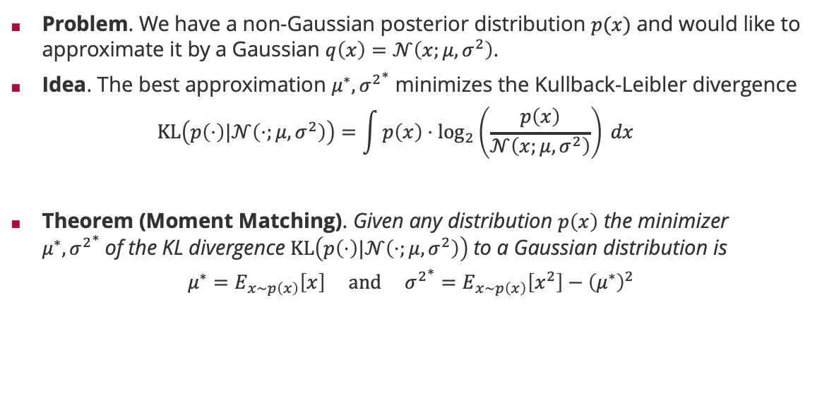
Information Theoretic Approximation: KL Divergence
Problem. We have a non-Gaussian posterior distribution $p(x)$ and would like to approximate it by a Gaussian $q\left(x\right)=𝒩\left(x;μ,σ^{2}\right)$.
Idea. The best approximation $μ^{∗},{σ^{2}}^{∗}$ minimizes the Kullback-Leibler divergence
$$KL\left(p\left(⋅\right)|𝒩\left(⋅;μ,σ^{2}\right)\right)=\int{p\left(x\right)⋅\log_{2}\left(\frac{p\left(x\right)}{𝒩\left(x;μ,σ^{2}\right)}\right) dx}$$
Theorem (Moment Matching). Given any distribution $p\left(x\right)$ the minimizer $μ^{∗},{σ^{2}}^{∗}$of the KL divergence $KL\left(p\left(⋅\right)|𝒩\left(⋅;μ,σ^{2}\right)\right)$to a Gaussian distribution is
$$μ^{∗}=E_{x∼p\left(x\right)}\left[x\right] and {σ^{2}}^{∗}=E_{x∼p\left(x\right)}\left[x^{2}\right]−{\left(μ^{∗}\right)}^{2}$$
Solomon Kullback (1909 – 1994)
Richard Leibler (1914 – 2003)

Slide 18



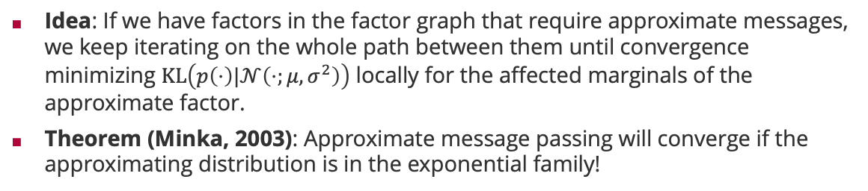



Expectation Propagation
Idea: If we have factors in the factor graph that require approximate messages, we keep iterating on the whole path between them until convergence minimizing $KL\left(p\left(⋅\right)|𝒩\left(⋅;μ,σ^{2}\right)\right)$ locally for the affected marginals of the approximate factor.
Theorem (Minka, 2003): Approximate message passing will converge if the approximating distribution is in the exponential family!
Tom Minka
1
1
1
$$x_{1}$$
$$x_{2}$$
$$x_{5}$$
8
4
7
8
2
5
$$x_{3}$$
$$x_{4}$$
3
6
iterate until convergence

Slide 19
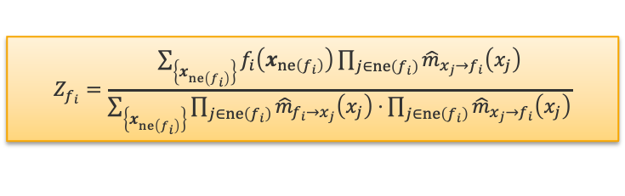
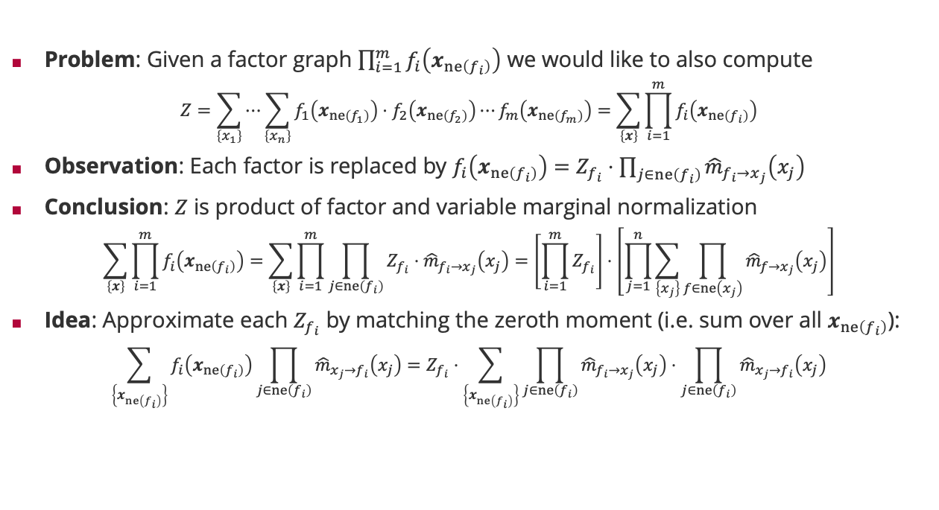
Approximating the Normalization Constant
Problem: Given a factor graph $\prod_{i=1}^{m}{f_{i}\left(x_{ne\left(f_{i}\right)}\right)}$ we would like to also compute
$$Z=\sum_{\left\{x_{1}\right\}}{⋯\sum_{\left\{x_{n}\right\}}{f_{1}\left(x_{ne\left(f_{1}\right)}\right)⋅f_{2}\left(x_{ne\left(f_{2}\right)}\right)⋯f_{m}\left(x_{ne\left(f_{m}\right)}\right)}}=\sum_{\left\{x\right\}}{\prod_{i=1}^{m}{f_{i}\left(x_{ne\left(f_{i}\right)}\right)}}$$
Observation: Each factor is replaced by $f_{i}\left(x_{ne\left(f_{i}\right)}\right)=Z_{f_{i}}⋅\prod_{j∈ne\left(f_{i}\right)}{{\hat{m}}_{f_{i}→x_{j}}\left(x_{j}\right)}$
Conclusion: $Z$ is product of factor and variable marginal normalization
$$\sum_{\left\{x\right\}}{\prod_{i=1}^{m}{f_{i}\left(x_{ne\left(f_{i}\right)}\right)}}=\sum_{\left\{x\right\}}{\prod_{i=1}^{m}{\prod_{j∈ne\left(f_{i}\right)}{Z_{f_{i}}⋅{\hat{m}}_{f_{i}→x_{j}}\left(x_{j}\right)}}}=\left[\prod_{i=1}^{m}{Z_{f_{i}}}\right]⋅\left[\prod_{j=1}^{n}{\sum_{\left\{x_{j}\right\}}{\prod_{f∈ne\left(x_{j}\right)}{{\hat{m}}_{f→x_{j}}\left(x_{j}\right)}}}\right]$$
$\text{Idea}\text{: }\text{Approximate} \text{each} Z_{f_{i}}$ by matching the zeroth moment (i.e. sum over all $x_{ne\left(f_{i}\right)}$):
$$\sum_{\left\{x_{ne\left(f_{i}\right)}\right\}}{f_{i}\left(x_{ne\left(f_{i}\right)}\right)\prod_{j∈ne\left(f_{i}\right)}{{\hat{m}}_{x_{j}→f_{i}}\left(x_{j}\right)}}=Z_{f_{i}}⋅\sum_{\left\{x_{ne\left(f_{i}\right)}\right\}}{\prod_{j∈ne\left(f_{i}\right)}{{\hat{m}}_{f_{i}→x_{j}}\left(x_{j}\right)}⋅\prod_{j∈ne\left(f_{i}\right)}{{\hat{m}}_{x_{j}→f_{i}}\left(x_{j}\right)}}$$
One normalization per factor
$$Z_{f_{i}}=\frac{\sum_{\left\{x_{ne\left(f_{i}\right)}\right\}}{f_{i}\left(x_{ne\left(f_{i}\right)}\right)\prod_{j∈ne\left(f_{i}\right)}{{\hat{m}}_{x_{j}→f_{i}}\left(x_{j}\right)}}}{\sum_{\left\{x_{ne\left(f_{i}\right)}\right\}}{\prod_{j∈ne\left(f_{i}\right)}{{\hat{m}}_{f_{i}→x_{j}}\left(x_{j}\right)}⋅}\prod_{j∈ne\left(f_{i}\right)}{{\hat{m}}_{x_{j}→f_{i}}\left(x_{j}\right)}}$$
Influence of all other factors on the zeroth moment approximation

Slide 20
Summary
Factor Graphs
Generalization of Bayesian networks specifically designed for fast inference
Date back to coding algorithms
Sum-Product Algorithm
Application of generalized distributive law
Trades memory (“messages”) for computation (“sums”)
Reduces the computational complexity to exponential in the largest out-degree of a factor rather than exponential in the number of variables
Approximate Message Passing and Expectation Propagation
Approximations will always be done on the marginals, not the messages!
When the Kullback-Leibler divergence is used as distance, all moments get preserved!

Slide 21
See you next week!

